Slide 1
Volume Continued
Week 8

Slide 2
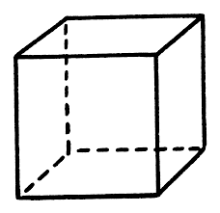
Let’s go Back to This Problem
How many 1 cm cubes can fit in the box? (hint:1m=100cm
2m
Answer:200*200*200=8,000,000 1cm cubes
2m
2m
This is known as a unit conversion, and we only use it when converting units. Do not cube anything else for volume.

Slide 3
Unit Conversions
1L=1000cm^3
Both Liters and cm are in a three-dimensional unit, so we do not need to cube anything.
Cm is a one-dimensional unit. That is why we cubed it in the last problem.

Slide 4
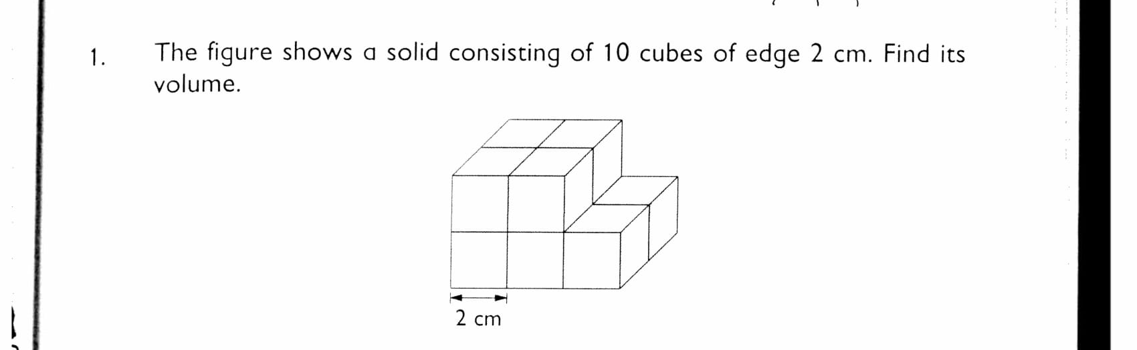
Let’s go Back to Question 1
After finding the volume of a 2cm cube (2*2*2=8cm^3), we multiply by 10 because there are 10 cubes with volume 8cm^3
We do not multiply by 10^3 because each cube has its own volume
That’s why we get 80cm^3 – not 8000 cm^3

Slide 5
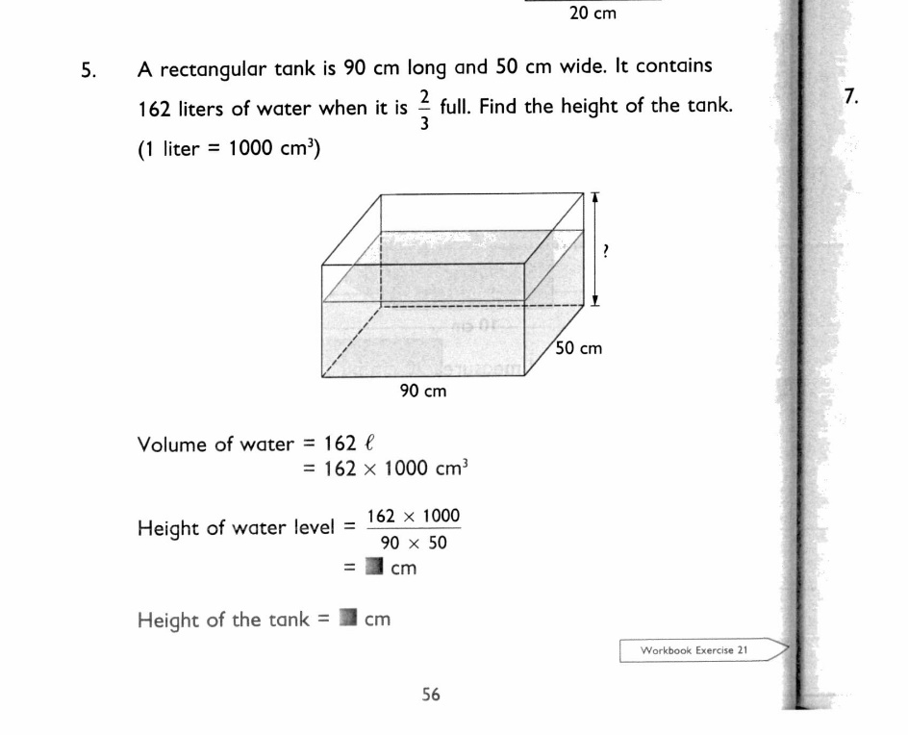
More Practice
5. Height of tank
=Height of water level times 3/2=54cm

Slide 6
Change in Volume
Some problems have a change in volume when an object is added into it.
We can find the volume of these objects by finding the change in height they made and multiply that by length times width.
Volume of object=Length*Width*Change in height

Slide 7
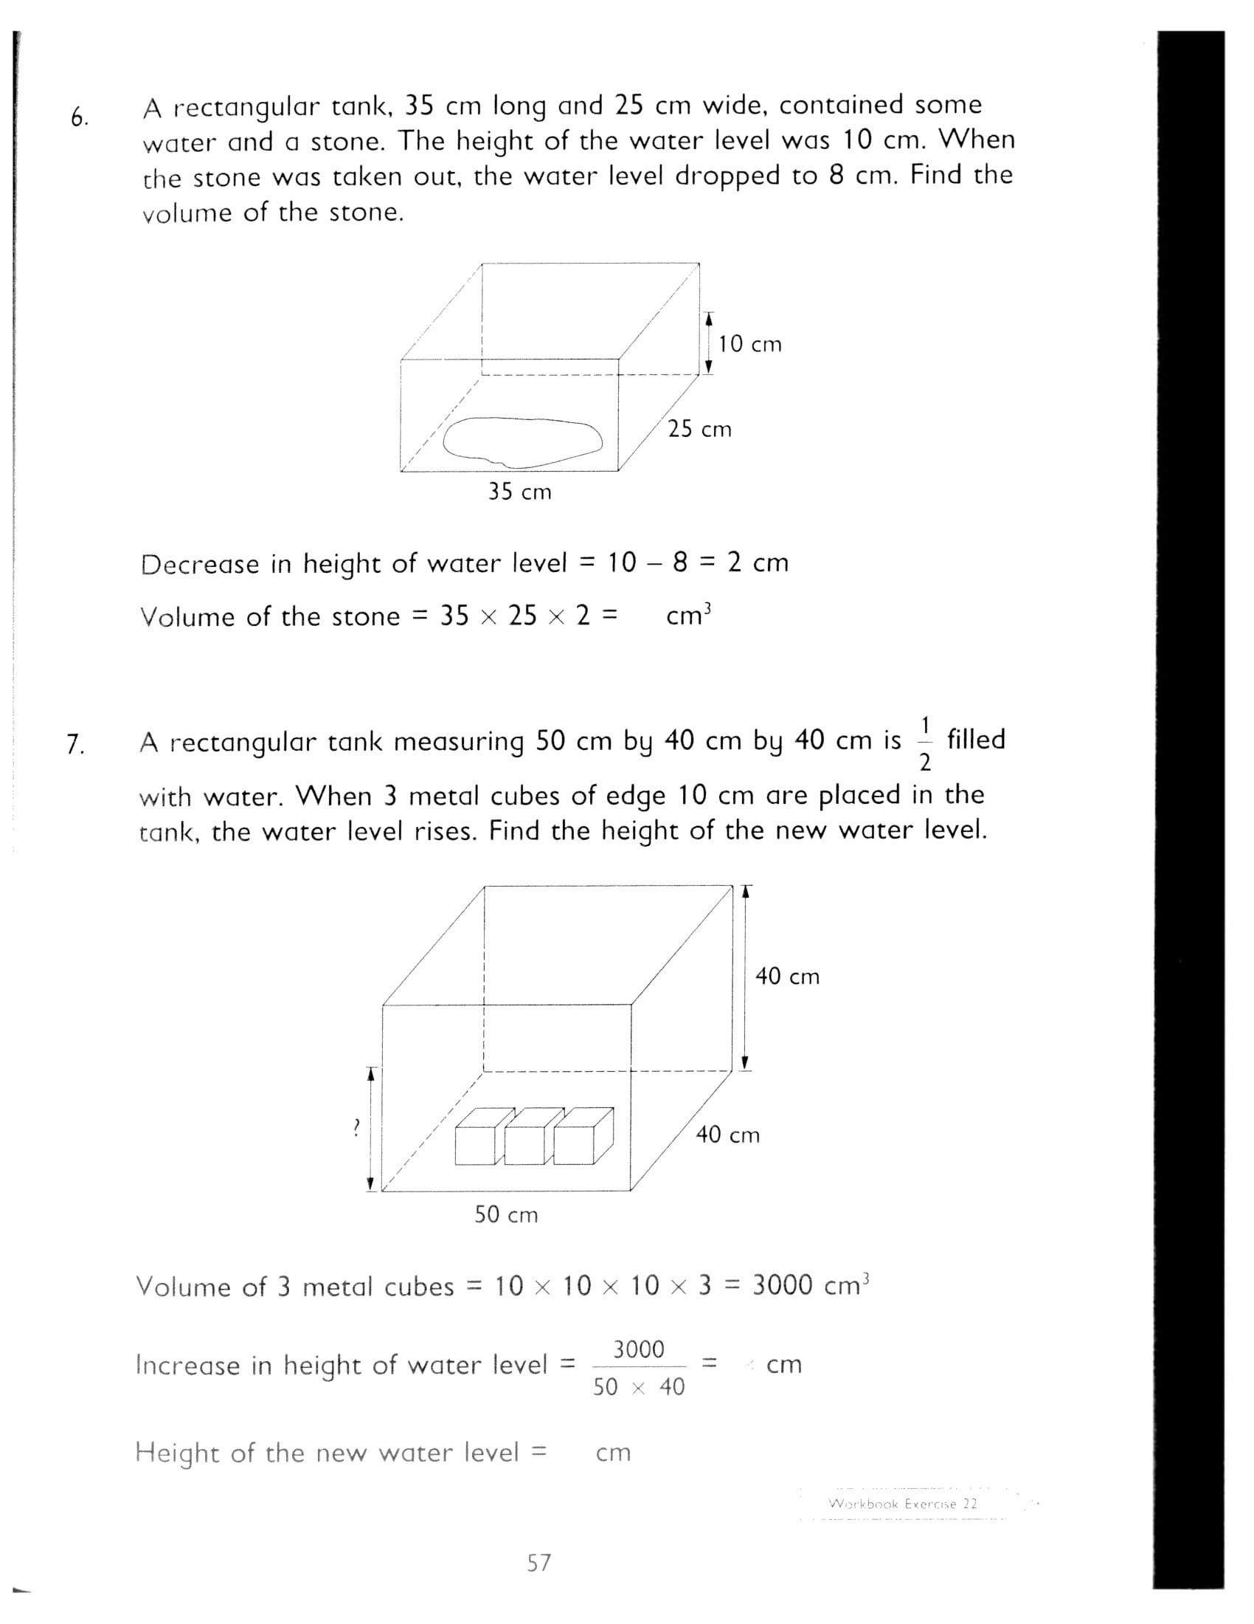
Practice Problems
6. 1750 cm^3
7. 21.5cm

Slide 8
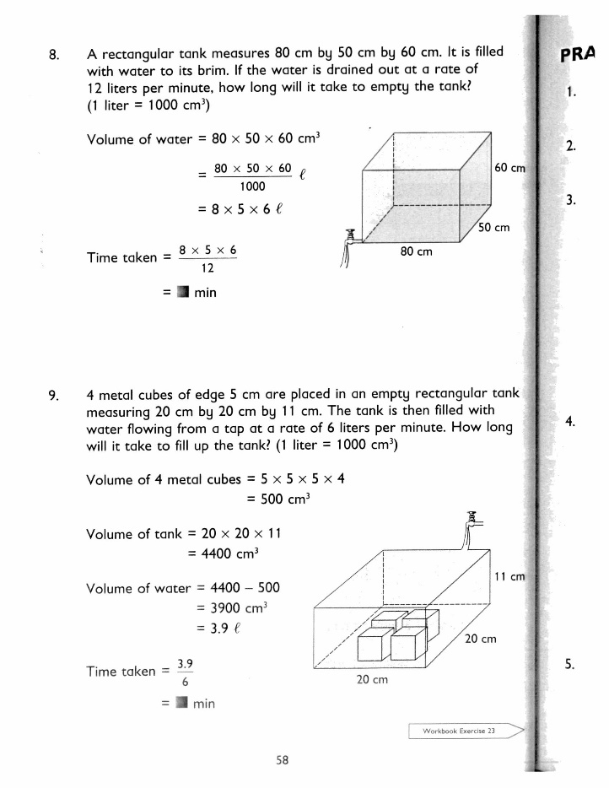
More Practice
8. 20 minutes
9. .65 minutes

Slide 9
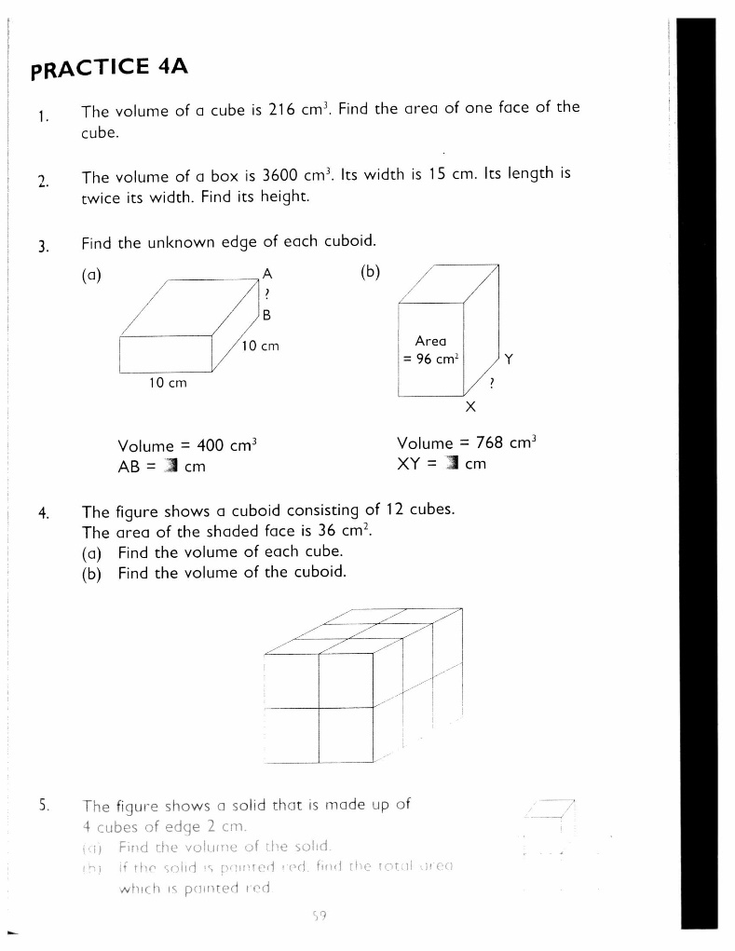
Practice 4A
1. 36
2. 8
3. a) 4 b) 8
4. 9cm^3 b) 96 cm^3
5. a) 32 cm^3 b)72 cm^2

