Slide 1
Volume

Slide 2
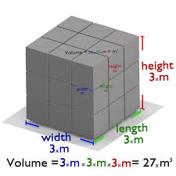
What is Volume?
It is the amount of space enclosed by an object
We find volume by doing L*W*H
Measured in [length]^3 (i.e., m^3, cm^3, ft^3 etc.)

Slide 3
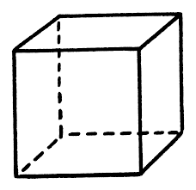
Quick Problem
Let’s say we had a cube with side length 2m each. How many 1m cubes can fit in the box?
<-Cube with side length 1m
2m
Answer:2*2*2=8 cubes
2m
How many 1 cm cubes can fit in the box? (hint:1m=100cm
2m
Answer:200*200*200=8,000,000 1cm cubes

Slide 4
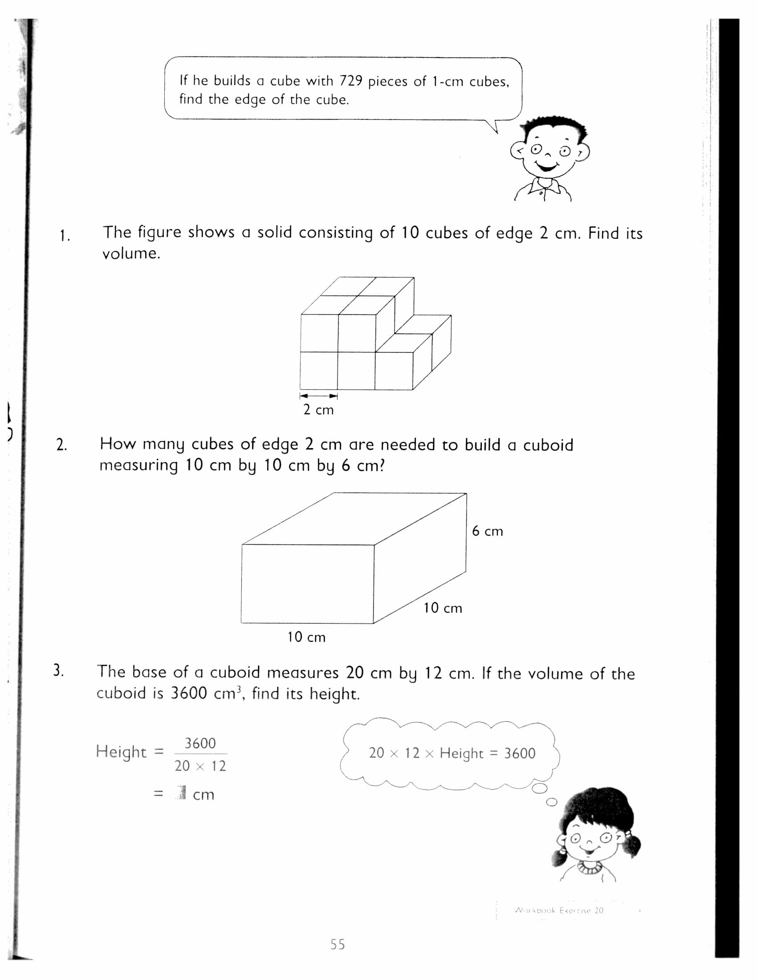
A Few More
80
75
15

Slide 5
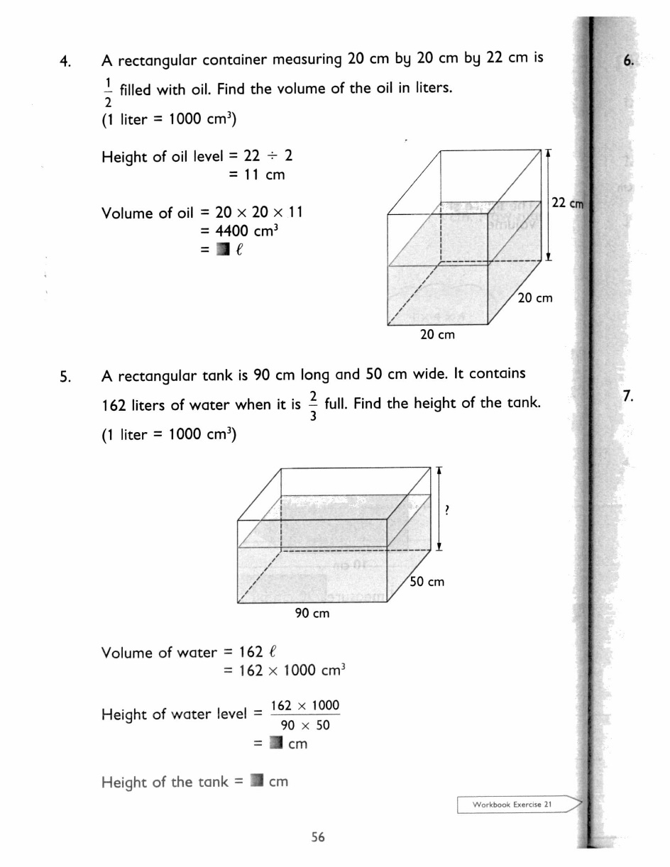
More Practice
4.4l
54

Slide 6
Change in Volume
Some problems have a change in volume when an object is added into it.
We can find the volume of these objects by finding the change in height they made and multiply that by length times width.
Volume of object=Length*Width*Change in height

