Slide 1
More Challenging Word Problems- Whole Numbers and Decimals, Fractions, and Ratios
Week 12

Slide 2
Why are all of these grouped under “Challenging Word Problems?”
Word problems are basically questioning where you are given a lot of conditions and solve for the question being asked.
When given a problem like this, you want to:
1. Find what the question is asking for
2. Draw diagrams and label the information given on the diagram (When applicable!)
3. Solve the diagram and solve the problem
Whole Numbers and Decimals, Fractions, and Ratios are all challenging word problems. They use what they are named.
These questions all have the same structure, and all of them are intuitive after a bit of practice.

Slide 3
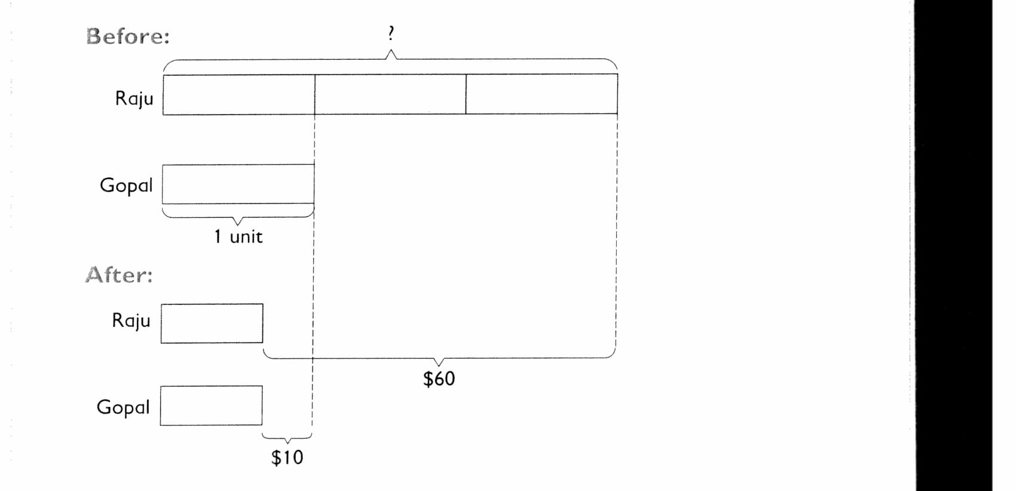
Whole Numbers and Decimals: Example
Raju had 3 times as much money as Gopal. After Raju spend $60 and Gopal spend $10, they each had an equal amount of money left. How much money did Raju have at first?
1. What is the question asking for?
How much money did Raju have at first?
2. Diagrams

Slide 4
Continued
3. Solve the Diagram and solve the problem
50 dollars=2 bars
3 bars=75 dollars=money Raju had at first

Slide 5
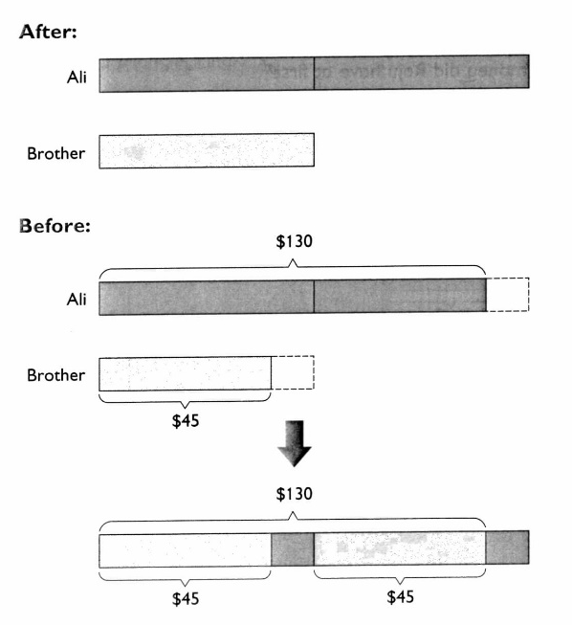
Guided Problem
Ali had $130 and his brother had $45. When their mother gave each of them an equal amount of money, Ali had twice as much money as his brother. How much money did their mother give each of them?
1. What is the question?
How much money did their mother give each of them?
2. Diagram (before and after)

Slide 6

Guided Problem Continued
3. Solve the diagram and the problem
Increase+45+45=130
Increase=40 dollars=amount of money given

Slide 7
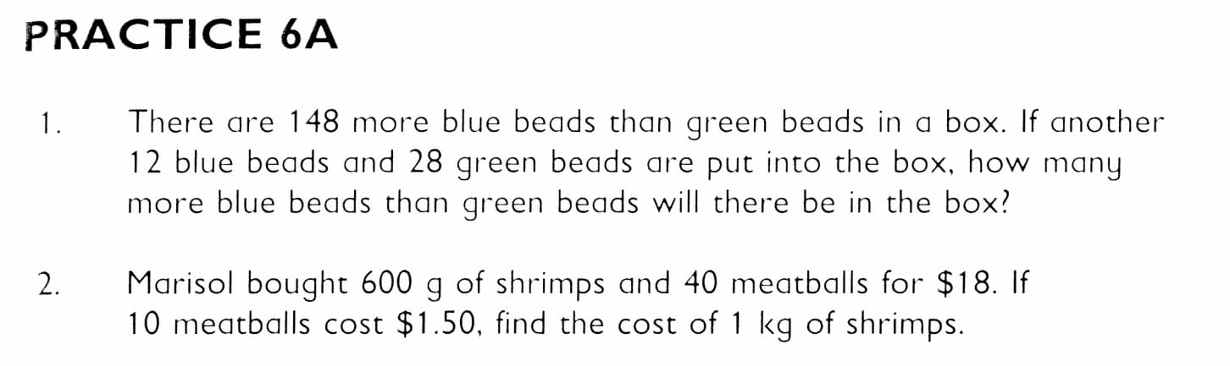
Practice Problems (6A)
Page 87 of textbook
1. 132 more blue than green
2. $20

Slide 8
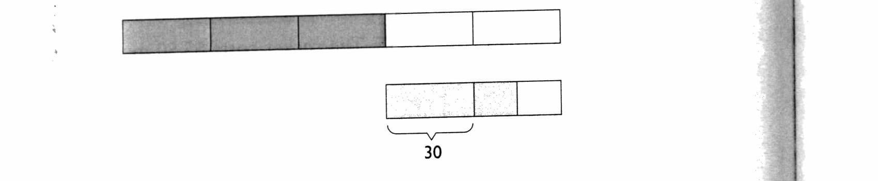
Fraction Problems
3/5 of the beads in a box are yellow beads. The rest are red beads and blue beads. There are twice as many yellow beads as red beads. There are 30 more red beads than blue beads. Find the total number of yellow and red beads.
1. What is the question?
Find the total number of yellow and red beads.
2. Diagram
yellow
red
3. Solve diagram and find answer
4.5 bars of 30=30 times 4.5=135

Slide 9
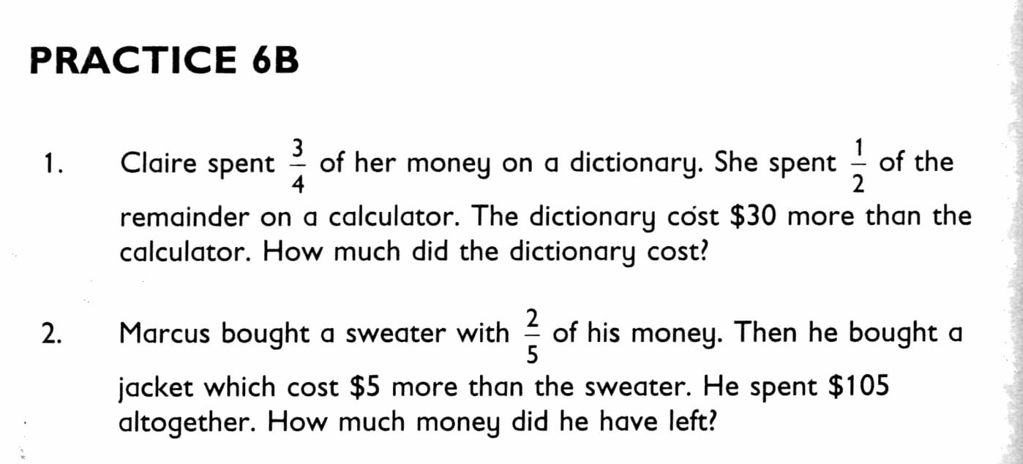
Practice 6B
Problems 1 and 2
1. 36 dollars
2. 20 dollars

Slide 10
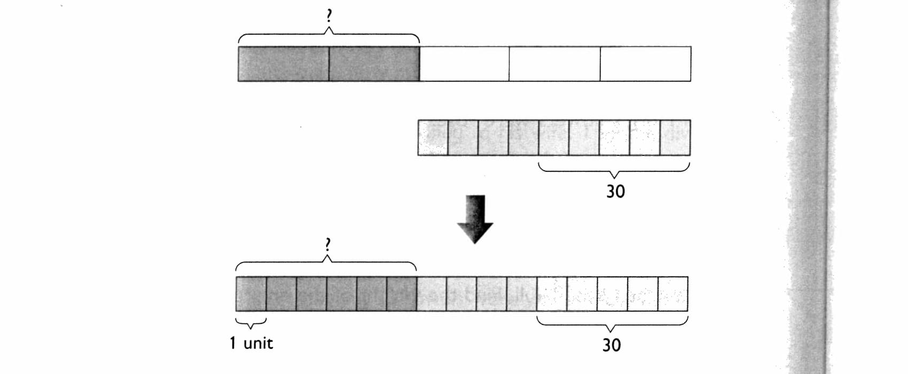
Ratio
2/5 of the beads in a box are yellow beads. The rest are red beads and blue beads. The ratio of the number of red beads to the number of blue beads is 4:5 If there are 30 blue beads, how many yellow beads are there?
1. What is the question?
How many yellow beads are there?
2. Diagram

Slide 11
Practice Continued
5 bars=30
1 bar=6
6 bars=36 yellow beads

Slide 12
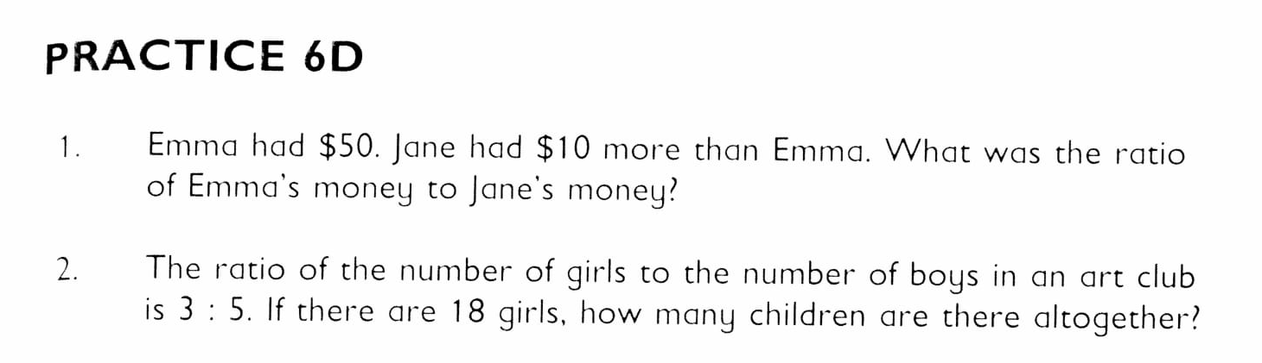
Practice 6d
Problems 1 and 2
50 dollars:60 dollars=5:6
18 girls=3 bars
1 bar=6 people
8 bars= 48 people

