Slide 1
More Challenging Word Problems- Percentages and Speed
Week 13

Slide 2
Percentages

Slide 3
Percentages
Pretty much fractions but in a different form.
1 in fraction amount=100%
You can convert fractions to percentages and vise-versa if you feel like one way is easier than the other.

Slide 4
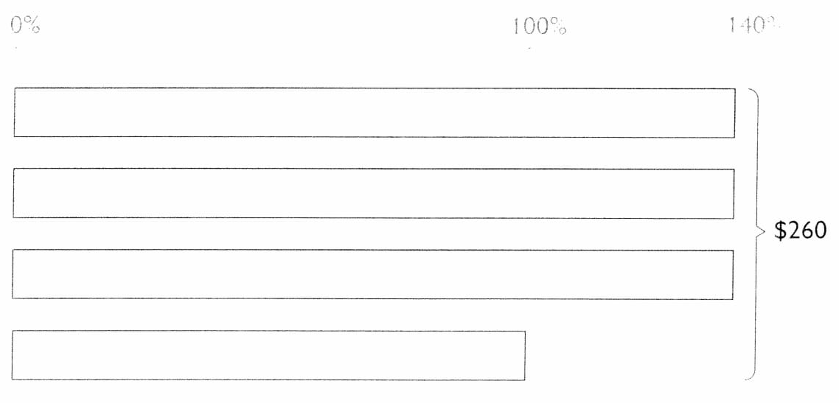
(Guided) Problem 1
A shopkeeper had 4 handbags which were of the same cost price. He sold 3 of them at 40% more than the cost price. He sold the fourth handbag at cost price. He received $260 altogether. Find the cost price of each handbag
What are we Looking for?
The cost price of each handbag
Total Percentage: 3(140%)+100%=520%
520%=$260
1%=$0.50
100%=cost of bag=$50

Slide 5
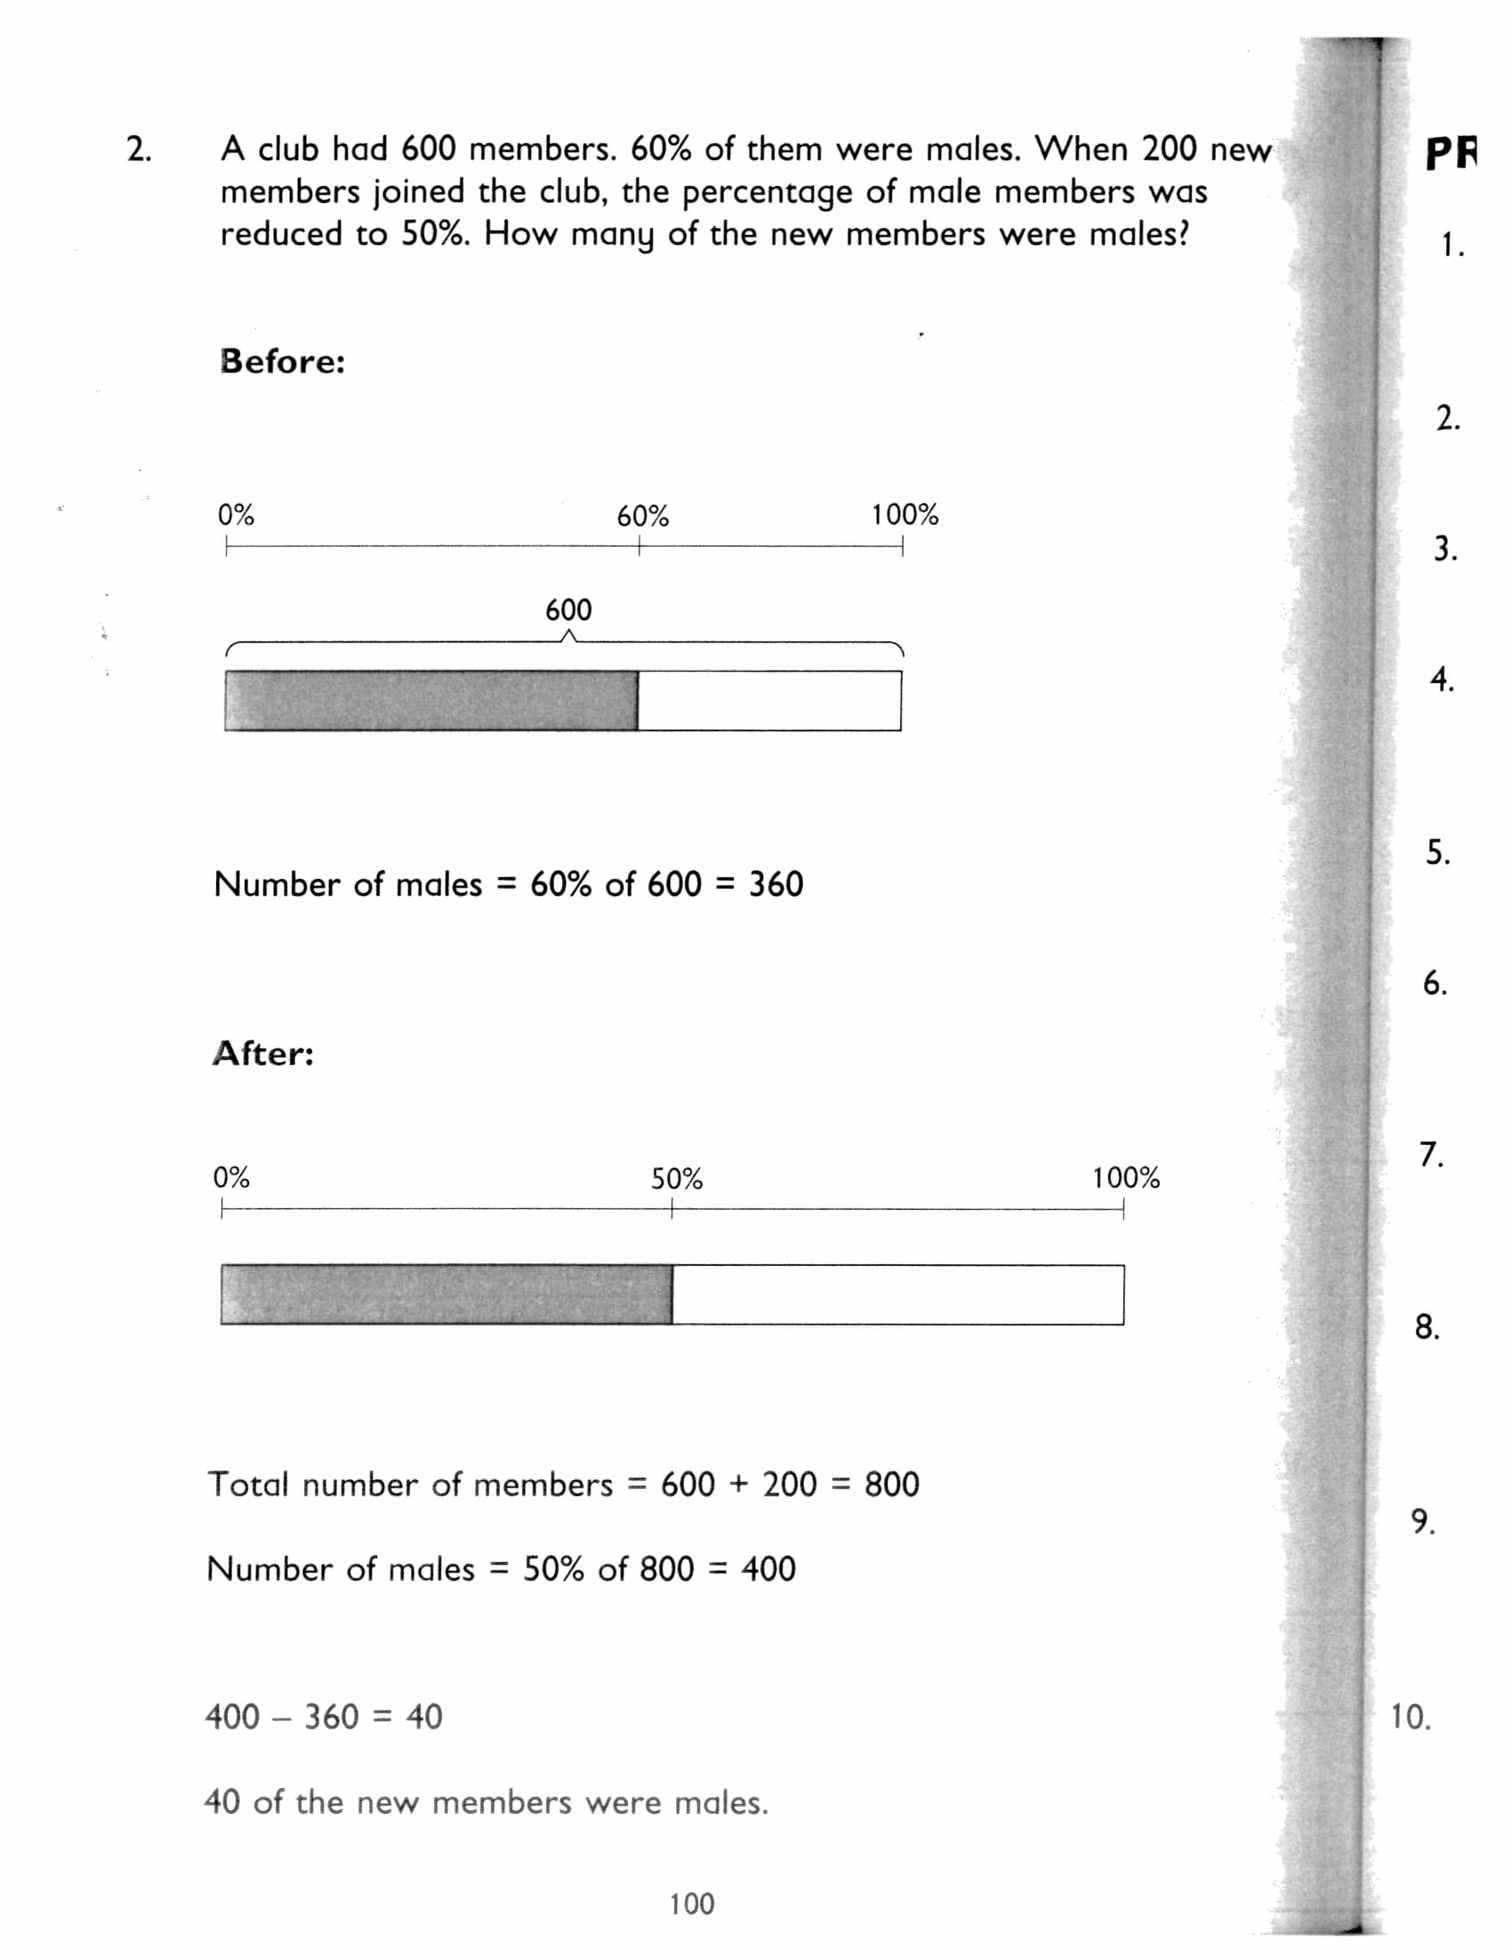
Problem 2
A club had 600 members. 60% of them were males. When 200 new members joined the club, the percentage of male members was reduced to 50%. How many of the new members were males?
What are we Looking for?
The number of new members that were males
How many males were there before and after?
Before: (.6)(600)=360. After: (.5)(600+200)=400
Change in males=males after-males before
400-360=40 new males

Slide 6
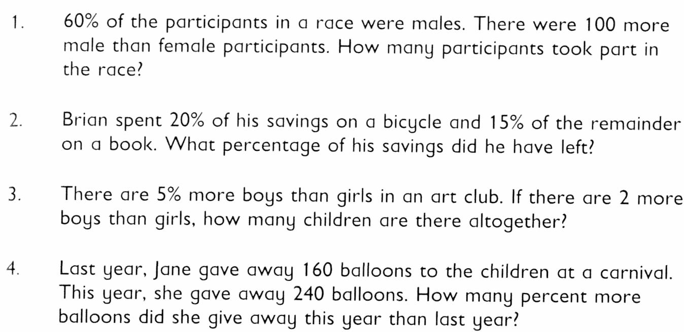
Practice Problems (6F)
1. 500 participants
2. 68 percent
3. 40 children
4. 50 percent more

Slide 7
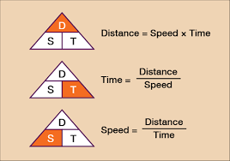
Speed
Remember: Speed=distance/time (meters/second)
Distance=speed*time (meters/second)*(second)=meters
Time=distance/speed (meters)/(meters/second)=seconds
Distance can be any distance (km, m, miles, etc.)
Time can be any unit of time (s, minutes, hours, etc)
But remember: Always do unit conversions if there are any!

Slide 8
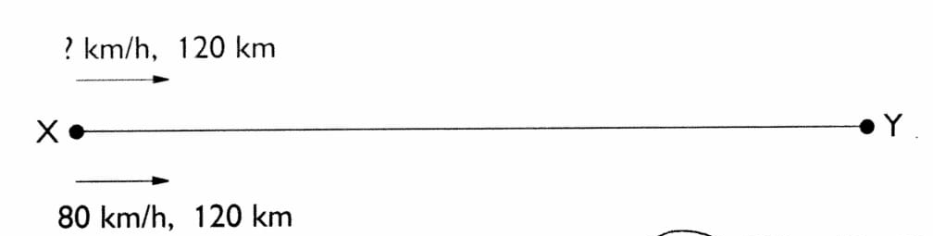
Guided Problem 1
Jeff and Cameron both drove a distance of 120km from Town X to Town Y. Cameron started the trip 30 minutes later than Jeff. They reached town A at the same time. If Cameron’s average speed was 80 km/h, find Jeff’s average speed
What is the question?
Find Jeff’s average speed
To Find Jeff’s average speed, we need the distance Jeff traveled and the time it took for him to travel that long
Jeff’s time=Cameron’s time+.5 hours
Cameron’s time=distance/speed=120/80=1.5 hours
Jeff’s time=1.5 hours+.5 hours=2 hours

Slide 9
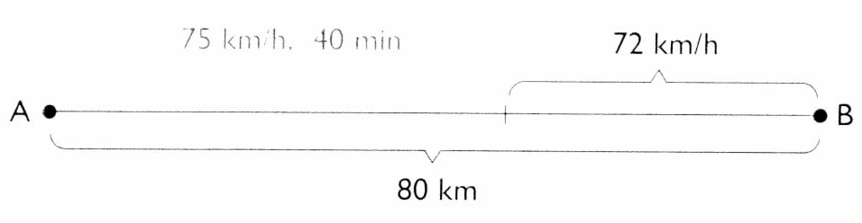
Problem 2
Mr. Stone drove a distance of 80km from Town A to Town B. He drove at an average speed of 75 km/h for the first 40 minutes. For the rest of the trip, he drove at an average speed of 72 km/h. If he left Town A at 8:30am, what time did he arrive at Town B?
1. What is the question?
What time did he arrive at Town B?
2 Times: Time spent at 1st (40 minutes) and time spent at 2nd.
Time (spent 2nd) =
distance (2nd)/speed
Distance=80km-(75)(2/3)=30 km
Time (spent at 72km/h) =distance/speed
=30/72=5/12 hours=25 minutes
To find the distance, you do total distance and subtract it from the distance traveled for the first 40 minutes
Total Time=40+25=65 minutes
He arrives Town B at 9:35am

Slide 10
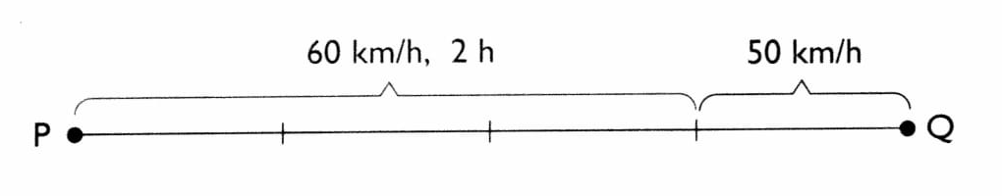
Problem 3
Mr. Gambani drove from Town P to Town Q. He took 2 hours to cover ¾ of the trip at an average speed of 60 km/h. He covered the remaining trip at an average speed of 50 km/h. If he arrived at Town Q at 12:00 noon. What time did he leave Town B?
What is the question?
What time did he leave Town B?
Distance he covered in first part=3/4ths of the whole trip= speed*time=(60)(2)=120km
12:00 noon-2 hours 48 mins=9:12 am
Last 1/4th of trip=40km
Time of remaining trip=distance/speed=4/5 hour
Total time= 2 hours+4/5=2 hours 48 minutes

Slide 11
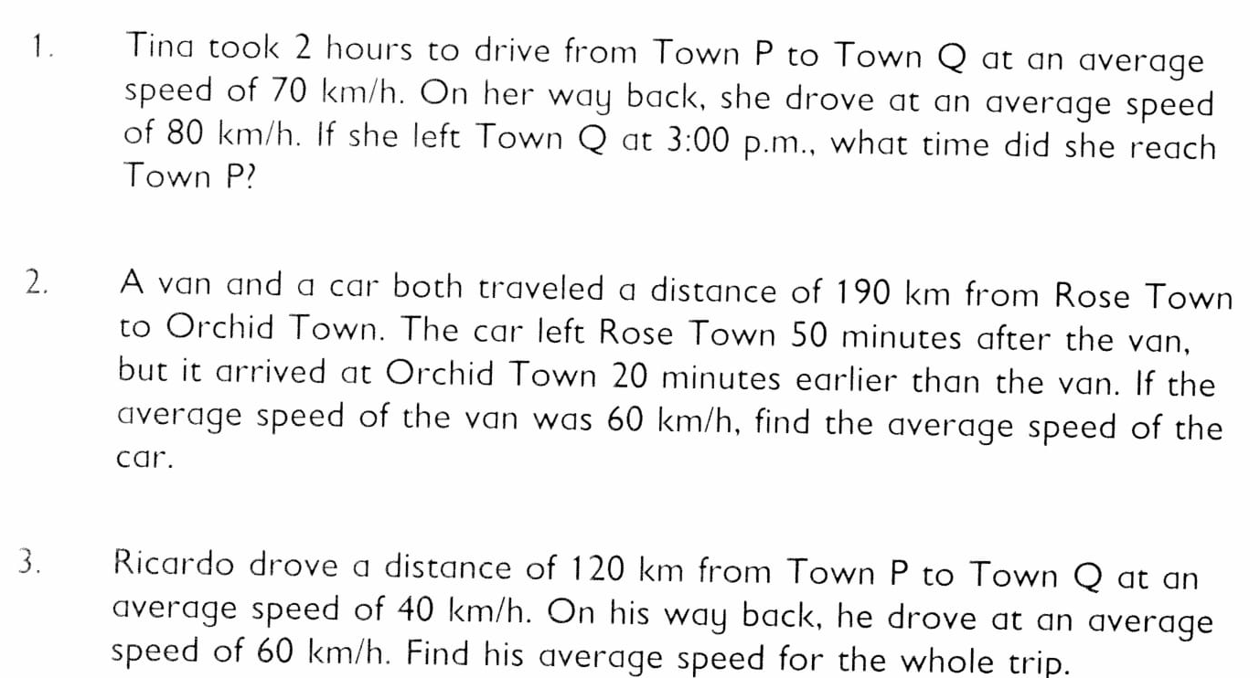
Practice Problems (6G)
1. 4:45 pm
2. 95 km/h
3. 48 km/h

