Slide 1
Fractions- PEMDAS and Fraction Word Problems
Week 2: January 21, 2023

Slide 2
Learning Objectives
We will be:
Reviewing and practicing PEMDAS
Solving multistep fraction word problems

Slide 3
Fraction- Order of Operations
PEMDAS
1. Parentheses
2. Exponents
3. Multiplication & Division
  If there is multiplication AND division, do from left to right
4. Addition & Subtraction
  If there is addition AND subtraction, do from left to right

Slide 4
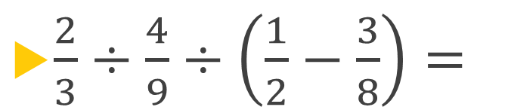
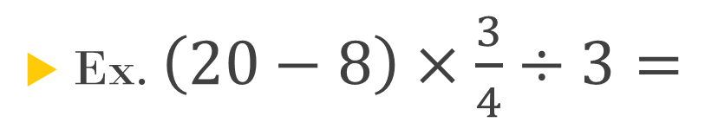
Ex. $\left(20−8\right)×\frac{3}{4}÷3=$
$\frac{2}{3}÷\frac{4}{9}÷\left(\frac{1}{2}−\frac{3}{8}\right)=$

Slide 5

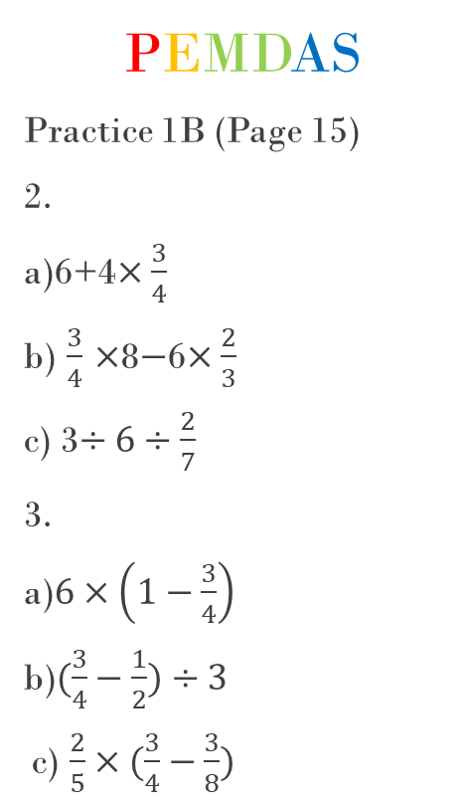
Fraction- Order of Operations Practice
PEMDAS
Practice 1B (Page 15)
2.
a)6+4$×\frac{3}{4}$
b) $\frac{3}{4}$ $×$8$−$6$×\frac{2}{3}$
c) 3$÷6÷\frac{2}{7}$
3.
a)$6×\left(1−\frac{3}{4}\right)$
b)$(\frac{3}{4}−\frac{1}{2})÷3$
c) $\frac{2}{5}×(\frac{3}{4}−\frac{3}{8})$
4.
a)$\left(20−8\right)×\frac{3}{4}÷3$
b)$(8+4)÷\frac{1}{2}×\frac{5}{6}$
c)$(20+12)÷12×\frac{3}{8}$
5.
a)$8−6×\frac{2}{3}÷2$
b)$16−4×2+4÷\frac{1}{2}$
c)$\frac{2}{5}×\left(18−3\right)+\frac{3}{10}$

Slide 6


Practice 1B Answers
2.
a) 9
b) 2
c) 24
3.
a) $\frac{3}{2}$
b) $\frac{1}{12}$
c) $\frac{3}{20}$
4.
a) 3
b) 20
c) 1
5.
a) 6
b) 16
c) 6$\frac{3}{10 } or\frac{63}{10}$

Slide 7
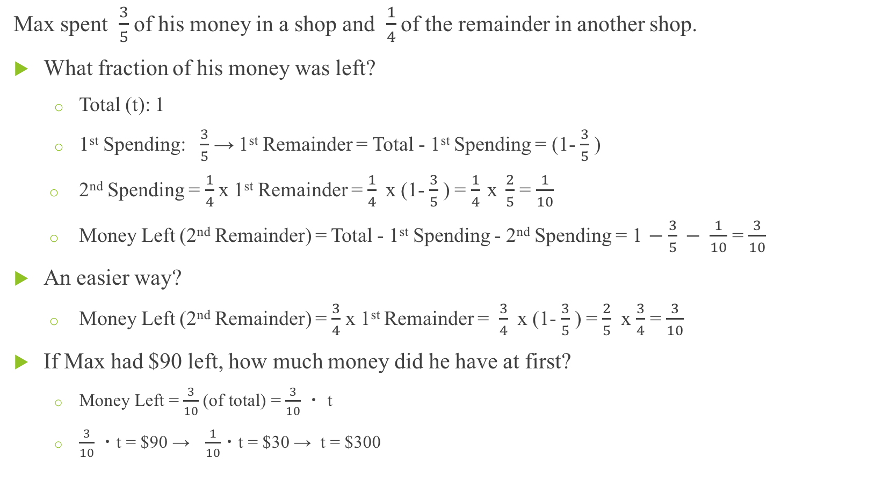
Fraction- Word Problem #1
Max spent $\frac{3}{5}$ of his money in a shop and $\frac{1}{4}$ of the remainder in another shop.
What fraction of his money was left?
  Total (t): 1
  1st Spending: $\frac{3}{5}$ → 1st Remainder = Total - 1st Spending = (1- $\frac{3}{5}$ )
  2nd Spending = $\frac{1}{4}$ x 1st Remainder = $\frac{1}{4}$ x (1- $\frac{3}{5}$ ) = $\frac{1}{4} \text{x} \frac{2}{5}$ = $\frac{1}{10}$
  Money Left (2nd Remainder) = Total - 1st Spending - 2nd Spending = 1 $−$ $\frac{3}{5} − \frac{1}{10}$ = $\frac{3}{10}$
An easier way?
  Money Left (2nd Remainder) = $\frac{3}{4}$ x 1st Remainder = $\frac{3}{4}$ x (1- $\frac{3}{5}$ ) = $\frac{2}{5}$ x $\frac{3}{4}$ = $\frac{3}{10}$
If Max had $90 left, how much money did he have at first?
  Money Left = $\frac{3}{10}$ (of total) = $\frac{3}{10}$ ・ t
  $\frac{3}{10}$ ・t = $90 → $\frac{1}{10}$・t = $30 → t = $300

Slide 8
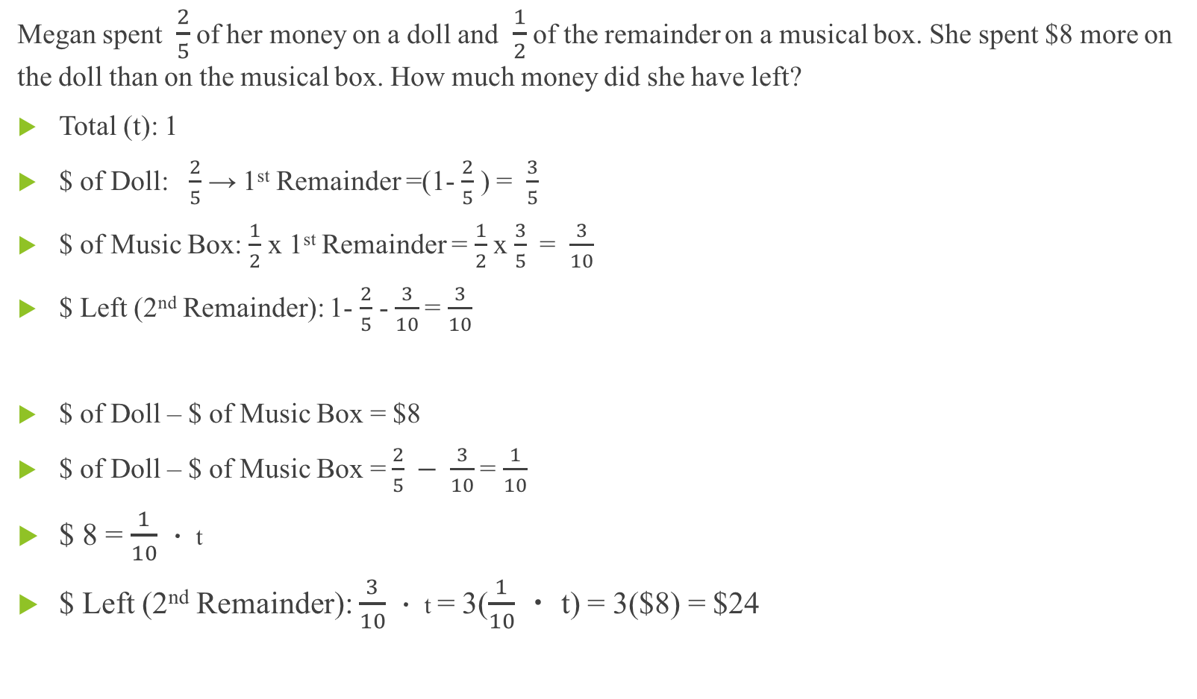
Fraction- Word Problem #2
Megan spent $\frac{2}{5}$ of her money on a doll and $\frac{1}{2}$ of the remainder on a musical box. She spent $8 more on the doll than on the musical box. How much money did she have left?
Total (t): 1
$ of Doll: $\frac{2}{5}$ → 1st Remainder =(1- $\frac{2}{5}$ ) = $\frac{3}{5}$
$ of Music Box: $\frac{1}{2}$ x 1st Remainder = $\frac{1}{2}$ x $\frac{3}{5}$ = $\frac{3}{10}$
$ Left (2nd Remainder): 1- $\frac{2}{5}$ -$\frac{3}{10}$ = $\frac{3}{10}$
$ of Doll – $ of Music Box = $8
$ of Doll – $ of Music Box =$\frac{2}{5} − \frac{3}{10}$ = $\frac{1}{10}$
  $ 8 = $\frac{1}{10}$ ・ t
  $ Left (2nd Remainder): $\frac{3}{10}$ ・ t = 3($\frac{1}{10}$ ・ t) = 3($8) = $24

Slide 9
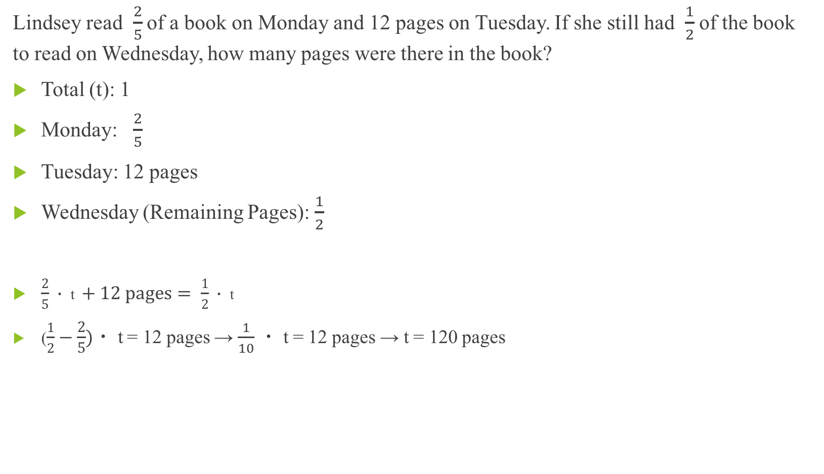
Fraction- Word Problem #3
Lindsey read $\frac{2}{5}$ of a book on Monday and 12 pages on Tuesday. If she still had $\frac{1}{2}$ of the book to read on Wednesday, how many pages were there in the book?
Total (t): 1
Monday: $\frac{2}{5}$
Tuesday: 12 pages
Wednesday (Remaining Pages): $\frac{1}{2}$
  $\frac{2}{5}\text{・ }\text{t} +12 pages= \frac{1}{2}\text{・ }\text{t}$
  ($\frac{1}{2}−\frac{2}{5})\text{・ }\text{t}$= 12 pages → $\frac{1}{10}$ $\text{・ }\text{t}$= 12 pages → t = 120 pages

Slide 10
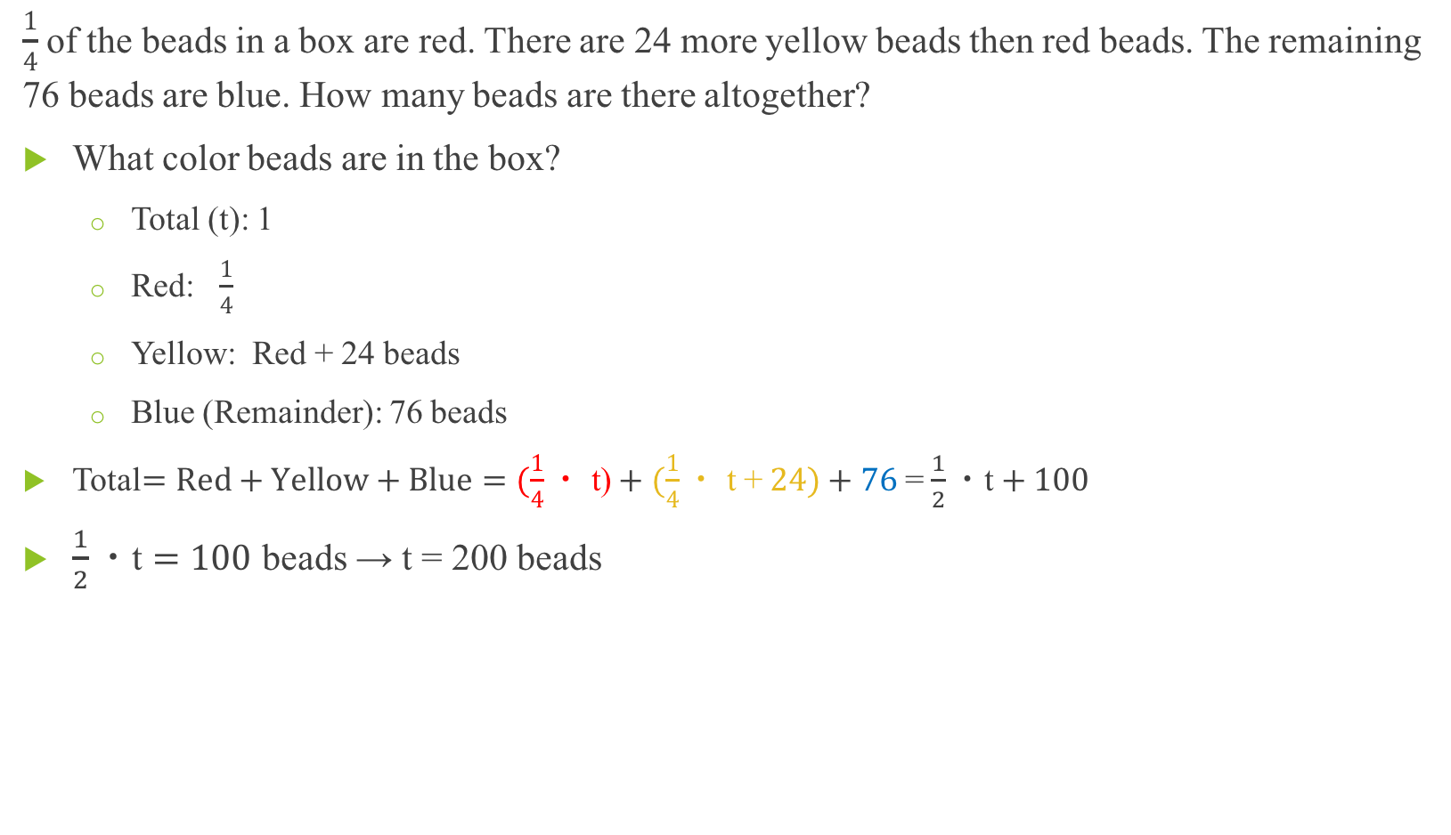
Fraction- Word Problem #4
$\frac{1}{4}$ of the beads in a box are red. There are 24 more yellow beads then red beads. The remaining 76 beads are blue. How many beads are there altogether?
What color beads are in the box?
  Total (t): 1
  Red: $\frac{1}{4}$
  Yellow: Red + 24 beads
  Blue (Remainder): 76 beads
Total$=Red+Yellow+Blue=(\frac{1}{4}\text{・ }\text{t}\text{)}+(\frac{1}{4}\text{・ }\text{t}\text{ +} 24)+76$= $\frac{1}{2}\text{・}\text{t}+100$
$\frac{1}{2}\text{・}\text{t}=100$beads → t = 200 beads

Slide 11
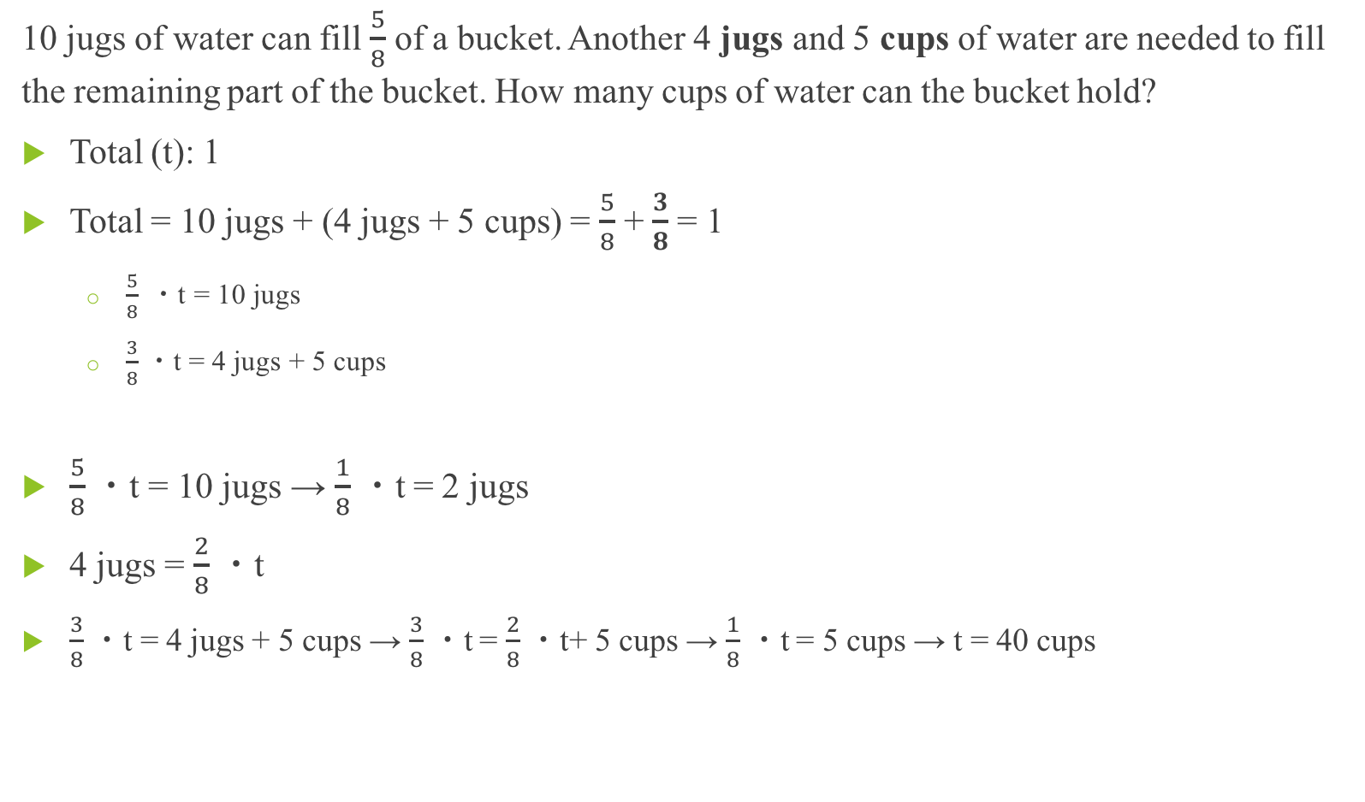
Fraction- Word Problem #5
10 jugs of water can fill $\frac{5}{8}$ of a bucket. Another 4 jugs and 5 cups of water are needed to fill the remaining part of the bucket. How many cups of water can the bucket hold?
Total (t): 1
Total = 10 jugs + (4 jugs + 5 cups) = $\frac{5}{8}$ + $\frac{3}{8}$ = 1
  $\frac{5}{8} \text{・}\text{t}\text{ = 10 }\text{jugs}$
  $\frac{3}{8}$ ・t = 4 jugs + 5 cups
$\frac{5}{8}$ ・t = 10 jugs → $\frac{1}{8}$ ・t = 2 jugs
4 jugs = $\frac{2}{8}$ ・t
  $\frac{3}{8}$ ・t = 4 jugs + 5 cups → $\frac{3}{8}$ ・t = $\frac{2}{8}$ ・t+ 5 cups → $\frac{1}{8}$ ・t = 5 cups → t = 40 cups

Slide 12
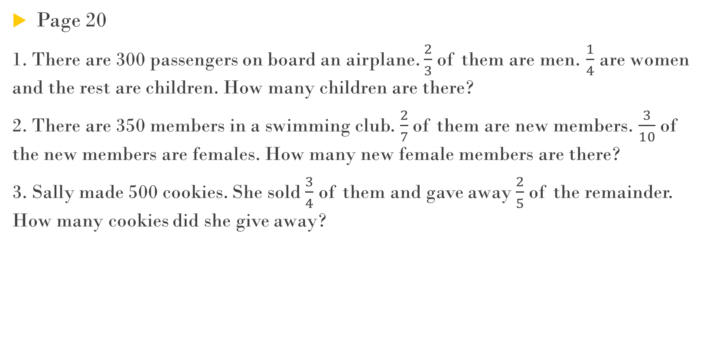
Fraction- Word Problem Practice 1C
Page 20
1. There are 300 passengers on board an airplane. $\frac{2}{3}$ of them are men. $\frac{1}{4}$ are women and the rest are children. How many children are there?
2. There are 350 members in a swimming club. $\frac{2}{7}$of them are new members. $\frac{3}{10}$ of the new members are females. How many new female members are there?
3. Sally made 500 cookies. She sold $\frac{3}{4}$ of them and gave away $\frac{2}{5}$ of the remainder. How many cookies did she give away?

Slide 13
Practice 1C Answers
1. 25 Children
2. 30 members
3. 50 cookies

Slide 14
Homework
Exercise 5 – Exercise 8 on WorkBook (Page 10 – Page 17)

